Slide 1
Community Meeting #2 | September 19, 2019
医院可行性研究
社区会议＃2 | 2019年9月19日
Notes:
Who opens? CEO?

Slide 2
Meeting Agenda
会议议程
医院可行性研究
General Hospital Feasibility Study Overview, including West Campus
综合医院可行性研究概述，包括園区
Open House – Visit Stations
开放日 – 実地現场访问
Q+A and Wrap-Up
提問問題和总结
Notes:
Kelly

Slide 3
医院可行性研究
Purpose of Today’s Meeting
今天会议的目的
Provide an overview of the General Hospital Feasibility Study, including West Campus
  概述综合医院可行性研究，包括園区
Hear how you think the building and West Campus could best be used to benefit the community, and what issues are most important to you
  听听您认为建筑和園区如何最好地用于社区，以及哪些问题对您最重要
Answer your questions about the Study
  回答您关于该研究的问题
Notes:
Kelly

Slide 4
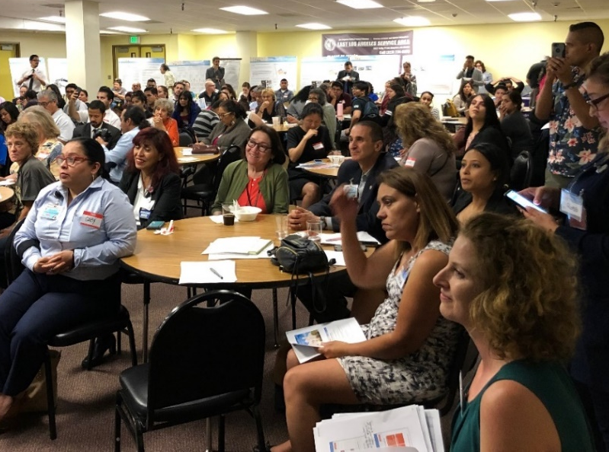
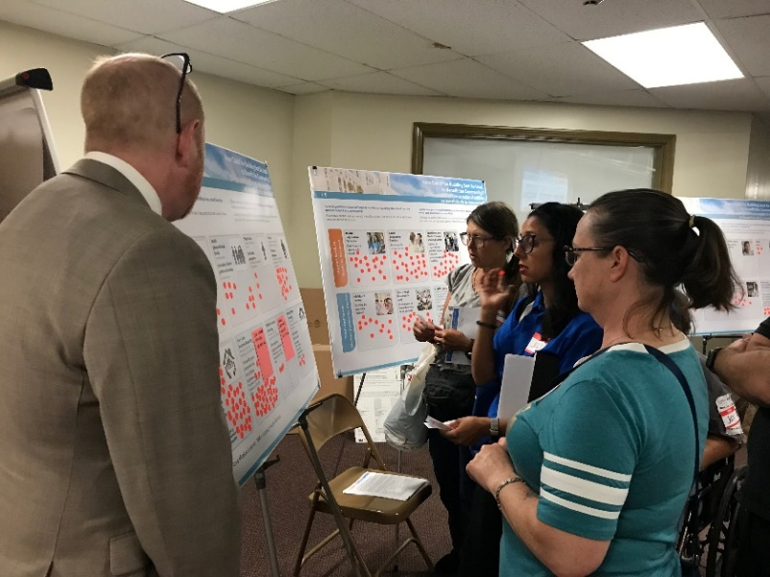
医院可行性研究
How Does Today’s Meeting Relate to Meeting #1?
今天的会议如何与会议＃1相关？
Community Meeting #1: June 13, 2019
社区会议＃1：2019年6月13日
Provide an overview of the General Hospital Feasibility Study 提供综合医院可行性研究的概述
  Discuss information we have discovered to date 讨论我们迄今发现的信息
  Hear how you think the building could be used to best benefit the community, and what issues are most important to you 听听您认为建筑物如何用于最大程度地造福社区，以及哪些问题对您来说最重要
  Answer your questions about the Study 回答您关于该研究的问题
Community Meeting #2: Today
今天 社区会议＃2：
Build upon the community feedback we received from Community Meeting #1 建立在我们从社区会议＃1收到的社区反馈的基础上
    Hear how General Hospital and West Campus could best be used to benefit the community ˙听听综合医院和園区如何最好地利用社区
Notes:
Kelly

Slide 5
Board of Supervisors Direction for the Study
监事会研究方向
医院可行性研究
  In November 2018 Supervisor Hilda L. Solis authored a board motion to study the re-use of General Hospital in order to: 2018年11月，主管Hilda L. Solis撰写了一份董事会动议，研究综合医院的再利用，以便：
Bring iconic County asset back to life 使标志性的县资产恢复生机.
Address the County’s tremendous need for homeless, low income, and high-need population residential options, and specifically in the area surrounding the LAC+USC Medical Campus 满足该县对无家可归，低收入和高需求人口住宅选择的巨大需求，特别是在LAC + USC医学园区周边地区
Complement the LAC+USC Foundation’s Wellness Center that provides wrap-around and community services and the future Restorative Care Village LAC + USC基金会健康中心的补充，提供环绕和社区服务以及未来的恢复护理村
Mission-aligned re-use as a housing and mixed-use building 任务一致的再利用作为住房和综合用途建筑
Notes:
Kelly

Slide 6
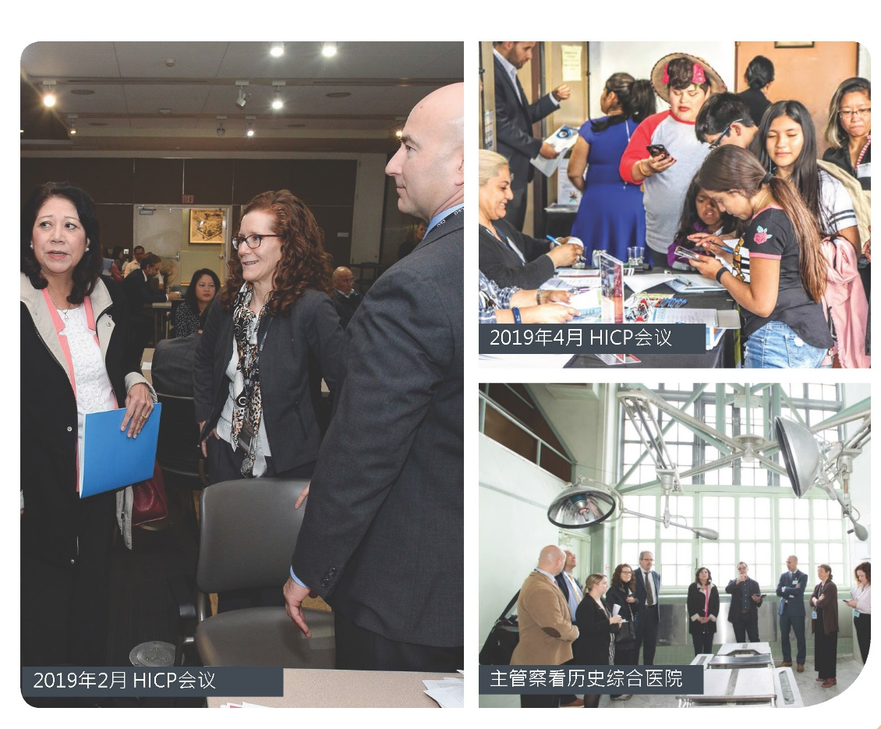
The Healthy Village Vision 健康的村庄愿景
医院可行性研究
The Study will help to achieve the Healthy Village vision, spearheaded by Supervisor Hilda L. Solis. 该研究将有助于实现健康村的愿景，由主管Hilda L. Solis带头。
A Whole Person Care concept to meet individuals’ needs
^{全身护理概念，以满足个人的需求}
^{A healthy and} economically resilient community in East LA
^{东洛杉矶一个健康且经济适应性强的社区}
Help most vulnerable population, and provide recuperative care and wraparound services to empower residents
帮助最脆弱勢的人群，并提供康复护理和环保服务，以增强居民的能力
Notes:
Kelly

Slide 7
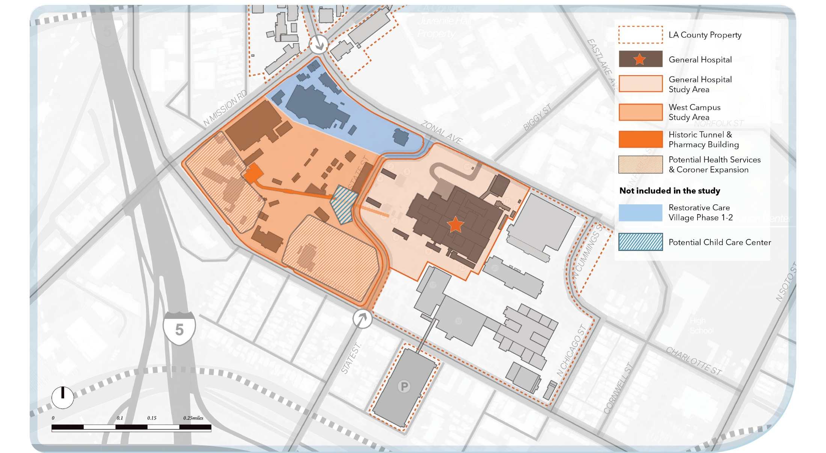
Study Area 研究区
医院可行性研究
以前的研究区域
综合医院
扩大研究区域
園区
Notes:
Deanna

Slide 8
Purpose of the Feasibility Study
可行性研究的目的
医院可行性研究
Effectively respond to the Board Motion
  有效回应理監會動議
Analyze the re-use of General Hospital and develop 3 financially feasible alternatives for consideration based on technical and community input from cross-disciplinary team
  分析综合医院的再利用根据跨学科团队的技术和社区意见，并开发3个经济上可行的替代方案供考虑
Develop a roadmap for implementation for the reuse of General Hospital and West Campus
    制定实施再利用的路线图综合医院和園区
  Engage County and community stakeholders throughout the process
      連結在整个过程中县和社区利益相关者
Notes:
Deanna

Slide 9
Why was the scope extended to West Campus?
为什么范围扩展到園区？
医院可行性研究
Support General Hospital re-use and provide expanded opportunities
支持综合医院重复使用并提供更多机会
Support integration of General Hospital re-use into the surrounding communities
  支持综合医院重复使用到周围社区
  Set aside areas for future County needs
  留出未来县需求的区域
Increase connectivity with other capital projects on the LAC+USC Medical Campus
  增加与LAC + USC醫療區的其他资本项目的连接
Holistically bring all components together under the Healthy Village vision
  根据健康村的愿景，将所有组成部分整合在一起
Address current and future transportation and accessibility challenges
  解决当前和未来的运输和可访问性挑战
Notes:
The Study area and scope expanded in March 2019 to include West Campus

Slide 10
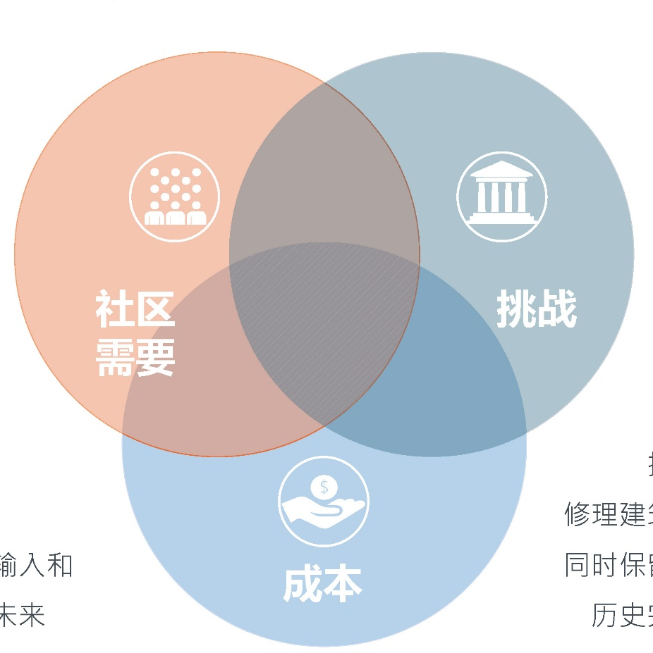
医院可行性研究
Determining Future Uses
确定未来的用途
多种机会提供给予建議塑造未来的
在保持历史完整性的同时修复建筑的挑战
在保持历史完整性的同时对建筑物进行维修的成本
Notes:
Deanna
There are many possible ways that General Hospital could be returned to productive uses. The Study will consider:
The Feasibility Study will develop a few potentially financially feasible options for future uses and the community will provide feedback, ultimately the Board of Supervisors will determine next steps.

Slide 11

Project Timeline 项目时间表
医院可行性研究
我们在这儿!
Notes:
Deanna

Slide 12
医院可行性研究
  Community Engagement
  社区参与
Notes:
Katherine

Slide 13
Community Engagement 社区参与
Community Engagement (CE) Team: AECOM + Barrio Planners (BPI) + Katherine Padilla & Associates (KPA) 社区参与（CE）团队：AECOM + Barrio Planners（BPI）+ Katherine Padilla＆Associates（KPA）
Close coordination with the Health Innovation Community Partnership (HICP) and the Community Engagement Steering Committee (CESC) 密切协调卫生创新社区伙伴关系（HICP）和社区参与指导委员会（CESC）
Robust and comprehensive with 5 Community At-Large Meetings 通过5次大型社区會議网络普通用户会议提供强大而全面的服务
Additional meetings, informal discussions with stakeholders; pop-up events 额外会议，与利益相关者的非正式讨 臨時活動
Communication tools: social media, media coordination, printed flyers, E-blasts etc. 沟通工具：社交媒体，媒体协调，印刷传单，电子報導等。
Notes:
Katherine

Slide 14
Community Engagement Steering Committee
社区参与指导委员会
Purpose
Volunteers representing community and organizations. Provide a coordinated mechanism for engagement by key stakeholders to help guide community engagement on the General Hospital Feasibility Study.
目的
代表社区和组织的志愿者。 为主要利益相关者提供协调机制，帮助指导社区参与综合医院可行性研究。
Notes:
Monica

Slide 15
Community Engagement Steering Committee
社区参与指导委员会
Role
Actively contribute in creating the General Hospital Feasibility Study Community Engagement Plan
Participate in implementing the plan and be advocates for the community engagement process
Advise on Strategies, Stakeholders and Community Issues
角色
积极参与制定综合医院可行性研究社区参与计划
参与实施计划并成为社区参与过程的倡导者
就战略，利益相关者和社区问题提供建议
Notes:
Monica

Slide 16
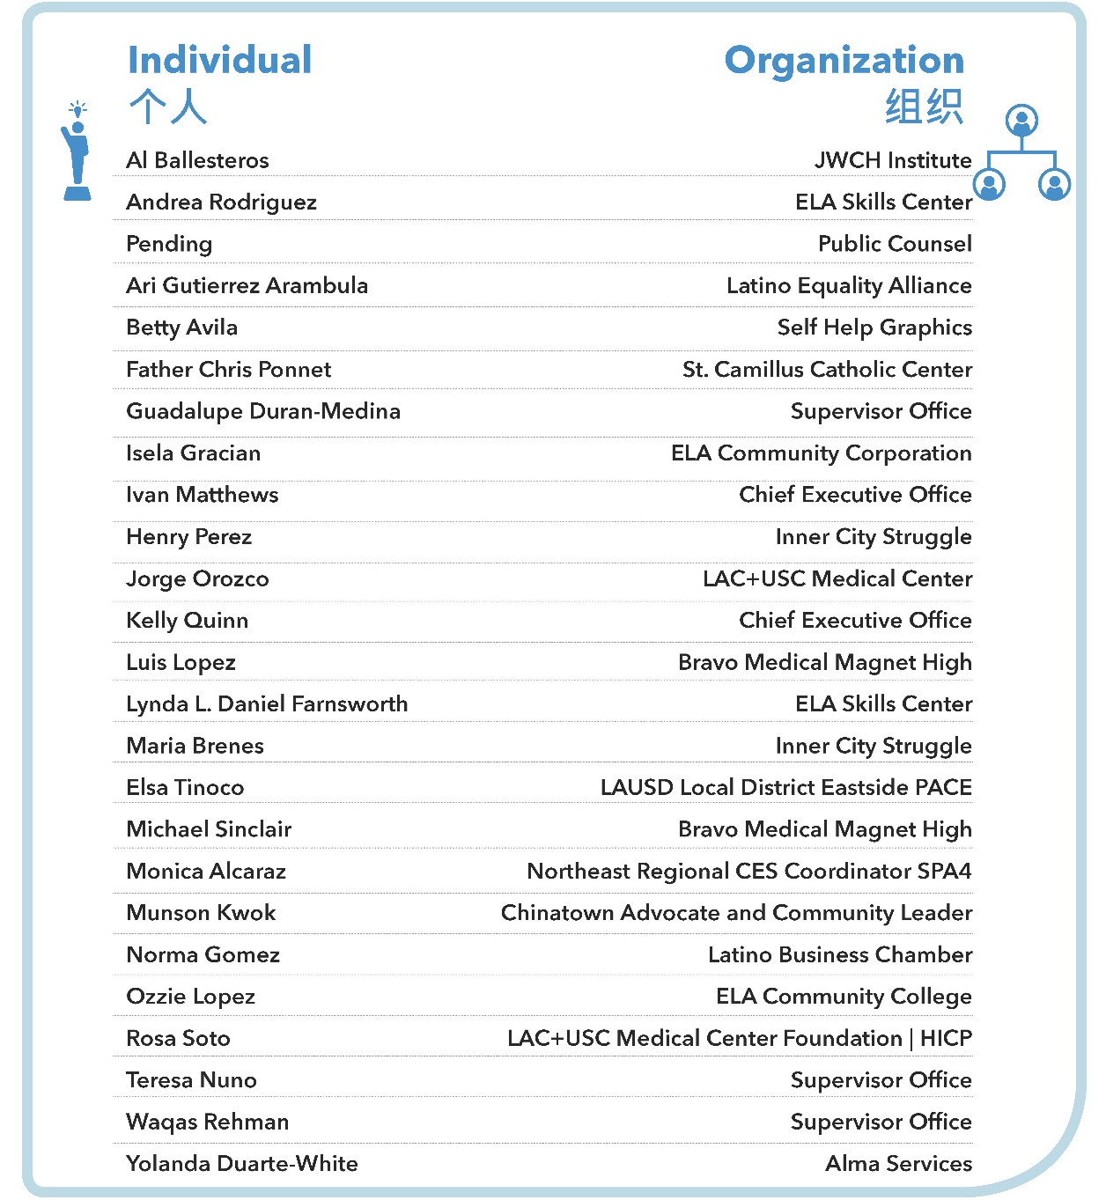
Community Engagement Steering Committee (CESC)
社区参与指导委员会
A big thank you to all of our volunteer CESC members that have spent countless hours helping guide the community engagement process
非常感谢所有志愿者CESC成员，他们花了无数个小时帮助指导社区参与过程
Notes:
Monica

Slide 17
医院可行性研究
  What do we know about General Hospital and West Campus?
  我们对综合医院和園区有什么了解？
Notes:
Robert

Slide 18
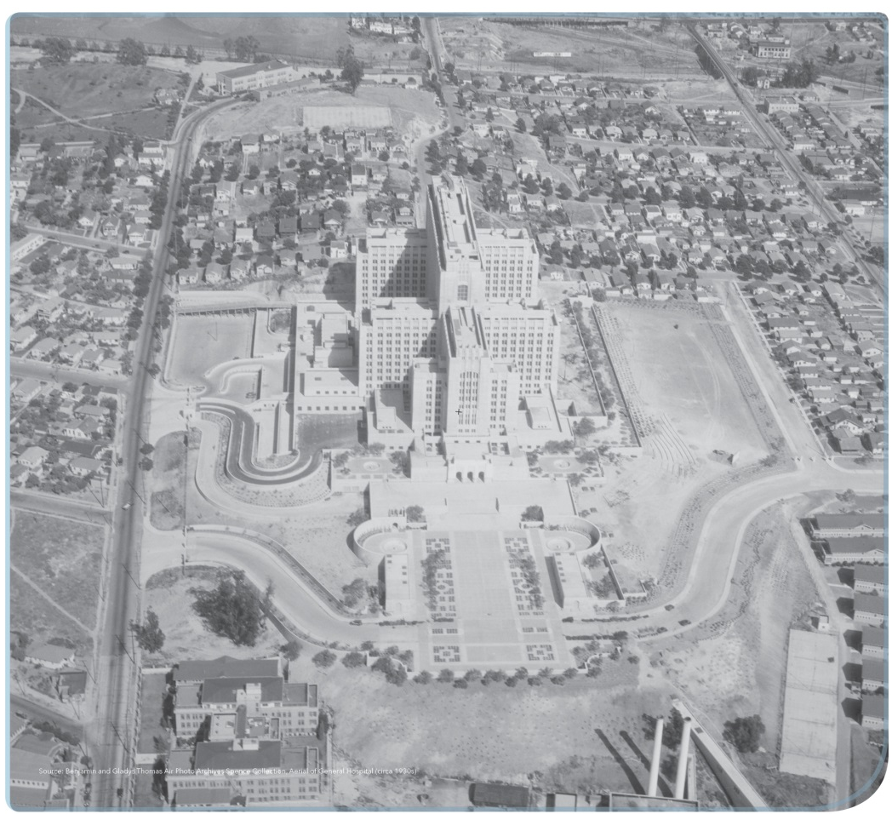
What Do We Know About the Building?
我们对建筑有什么了解？
86 years old, 19 stories
86岁屋齡，19層高
1.3 million square feet
  130万平方英尺
Officially determined eligible for listing on the National Register of Historic Places
  正式确定有资格在国家史迹名录上
Notes:
Robert

Slide 19
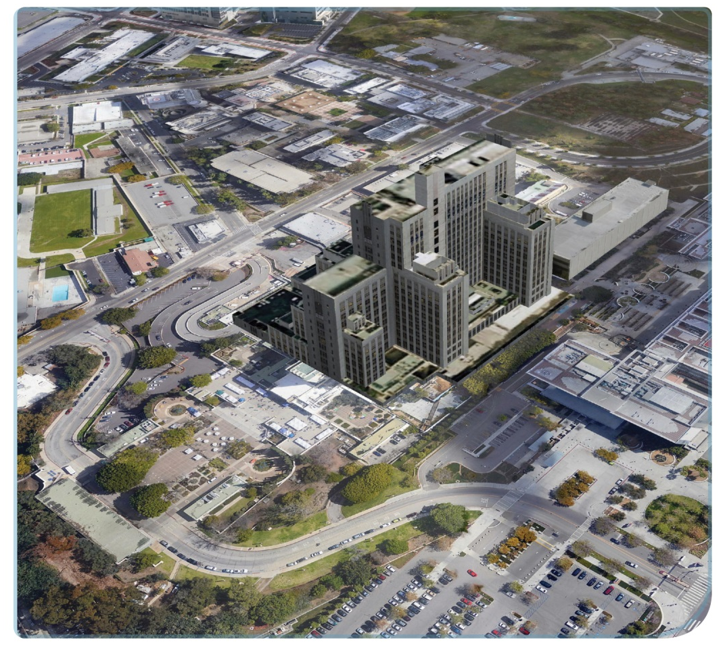
What Do We Know About the Building?
我们对建筑有什么了解？
Once held 1,200 hospital beds; today is largely vacant
  曾经有1200张病床; 今天大多是空床
Current uses include DHS, the Wellness Center, and Navy Medicine Operational Training Center
目前的用途包括DHS，健康中心和海军医学操作培训中心
Notes:
Robert

Slide 20
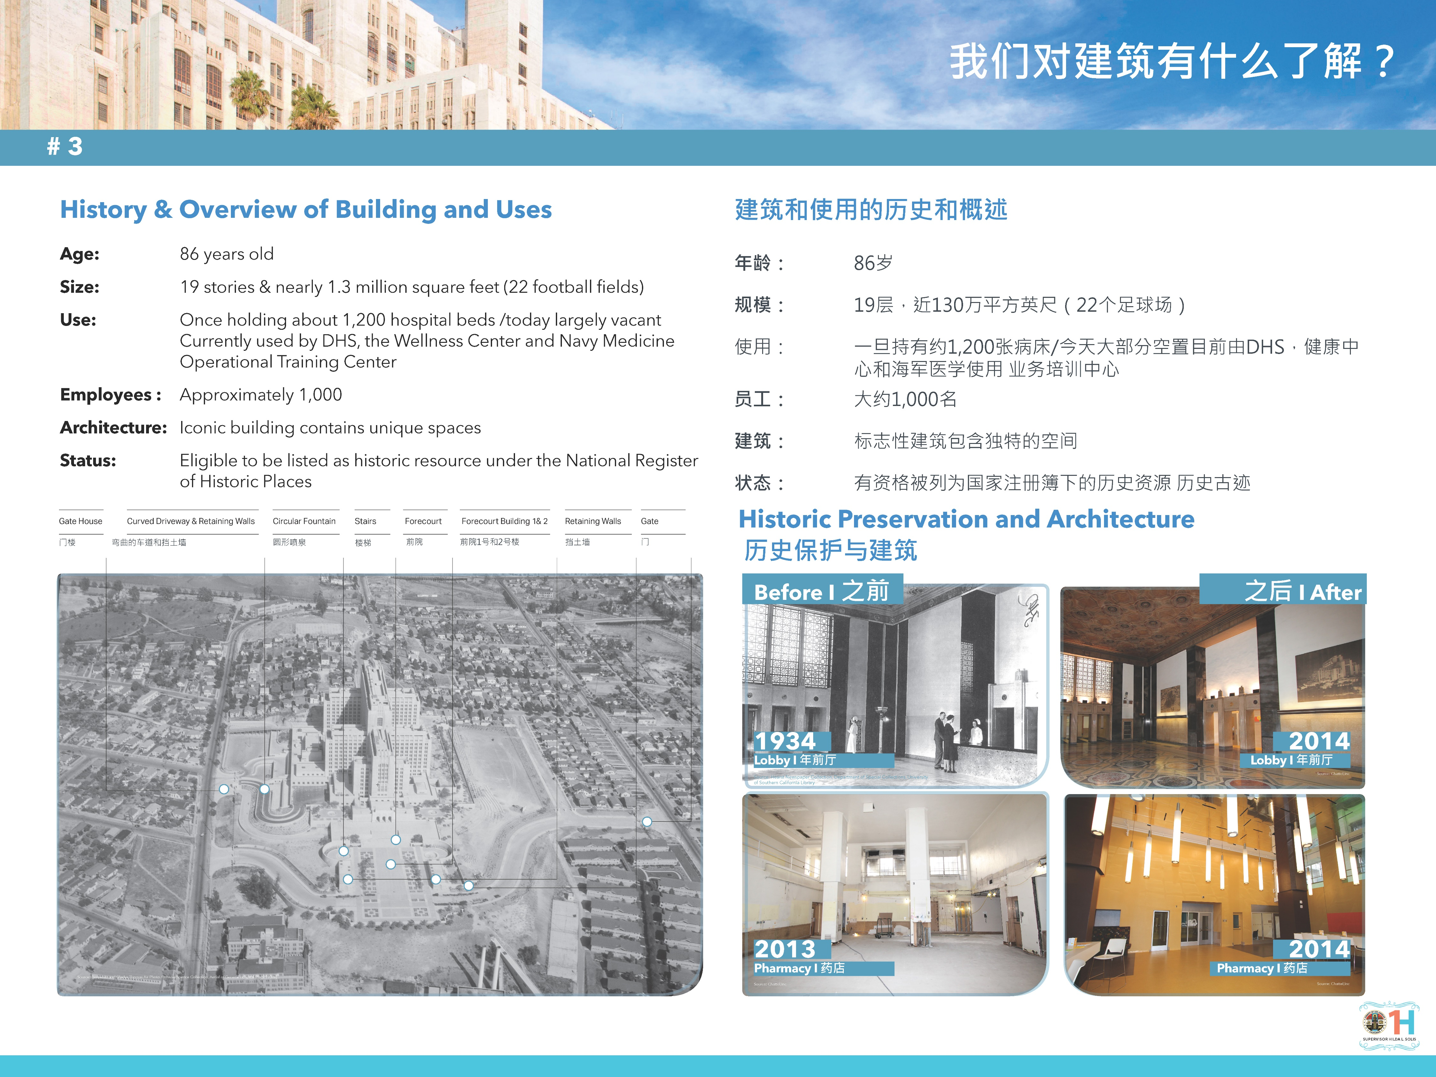
Historic Preservation and Architecture
历史保护与建筑設計
Notes:
Robert

Slide 21
Historic Preservation and Architecture
历史保护与建筑設計
Notes:
Robert

Slide 22
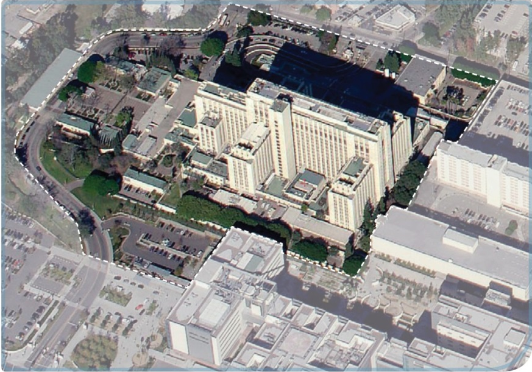
What Improvements Are Needed?
需要什么改进？
Structural Wall/ Foundation Strengthening
Hazardous Material and Lead Abatement
New Fire Protection, AC, Heating, Plumbing and Electrical
  Maintain Historic Spaces
Develop Parking Solutions
Improve Public Transit & Pedestrian Access
结构墙/地基加固
有害物质和铅物质消除
新的防火，交流，供暖，管道和电气
保持历史空间
开发停车解决方案
改善公共交通和行人通道
Notes:
Deanna

Slide 23
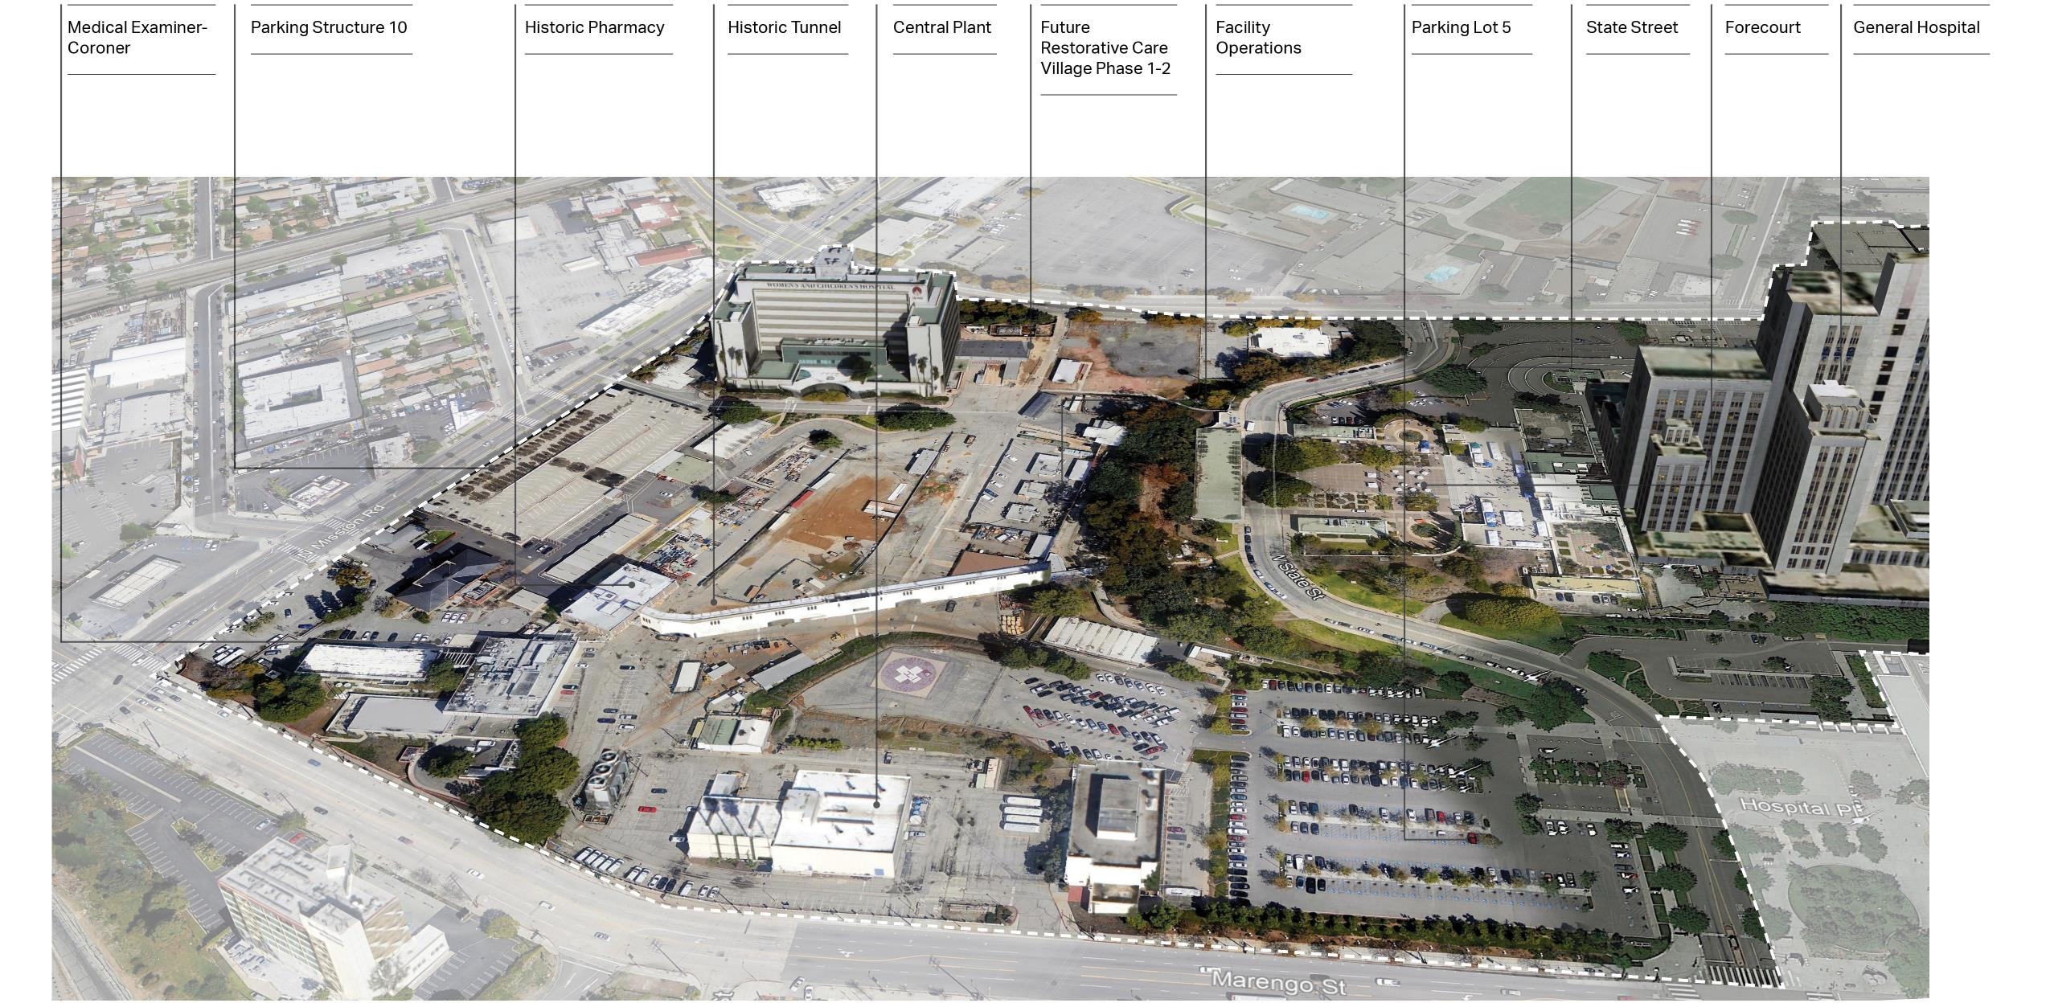
What Do We Know About West Campus?
我们对園区有什么了解？
医学检查员 - 验尸官
停车结构10
历史性药店
历史悠久的隧道
中央工厂
设施运营
停车场5
State 街
前院
綜合医院
未来的恢复保健村第1-2阶段

Slide 24
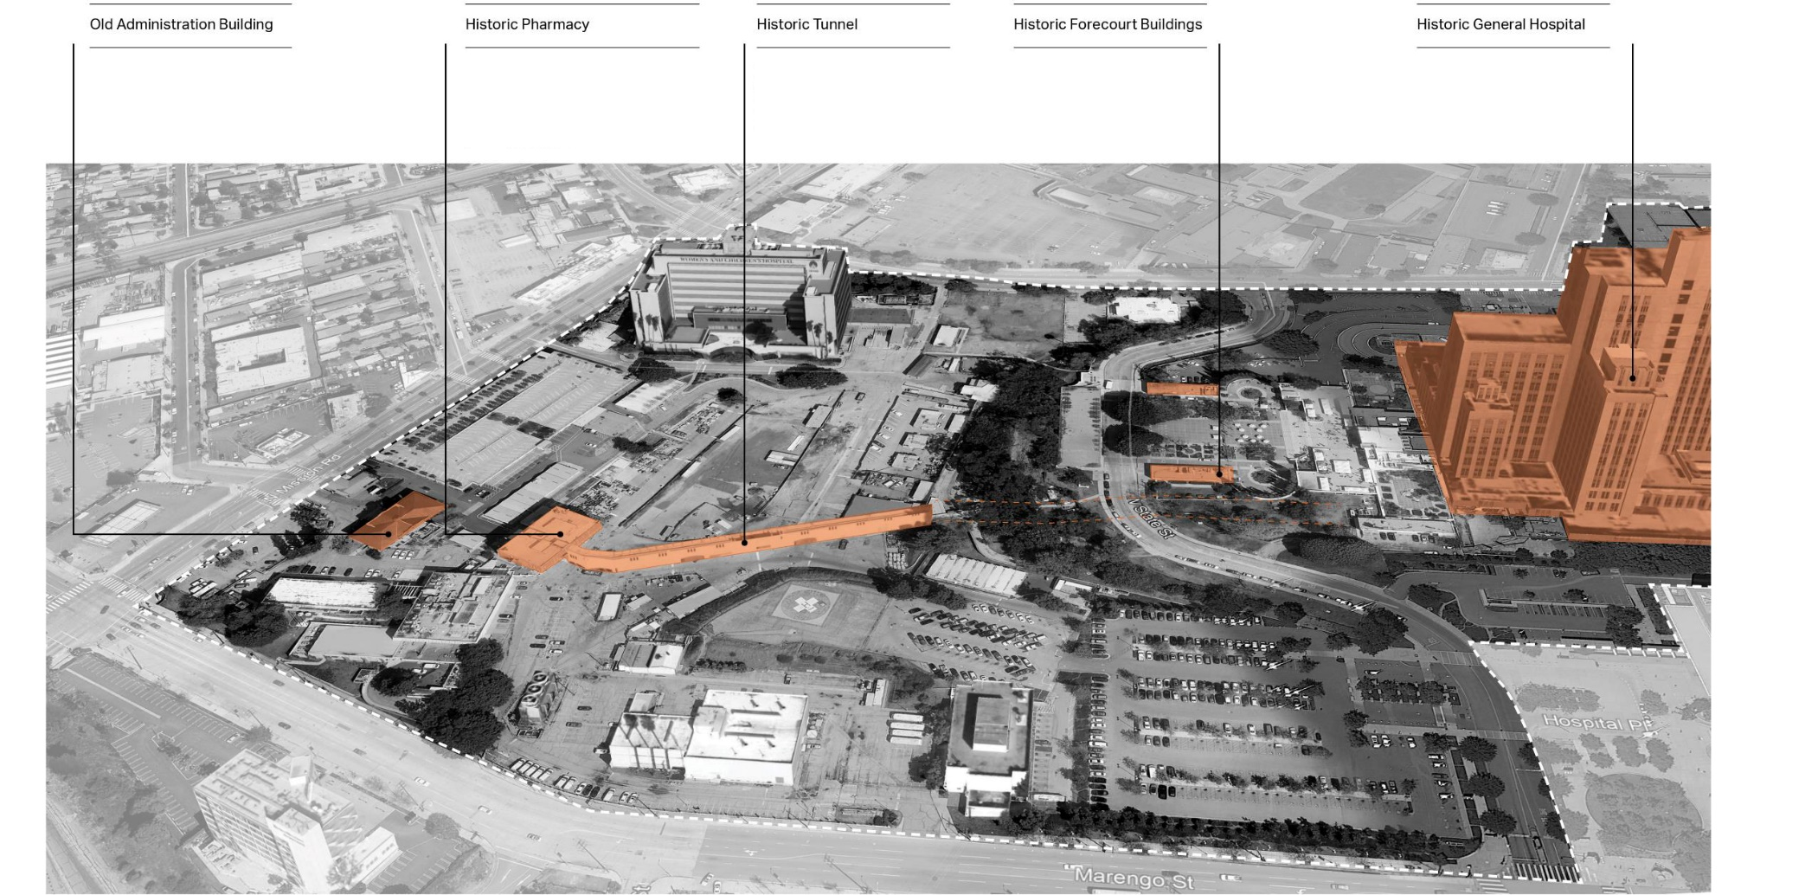
What Do We Know About West Campus?
我们对園区有什么了解？
旧行政大楼
历史性药店
历史悠久的隧道
历史悠久的前哨建筑
綜合医院
Buildings/structures in orange are formally determined eligible for the National Register of Historic Places
橙色的建筑物/结构正式确定有资格获得国家史迹名录

Slide 25
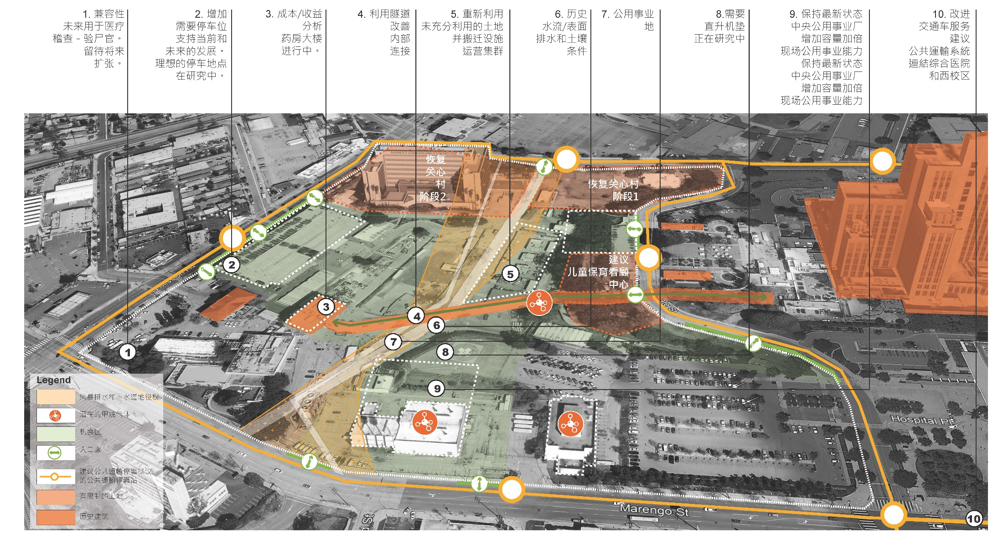
What Improvements Are Needed on West Campus?
在園區需要改进什么？

Slide 26

What are the Main Challenges?
主要挑战是什么？
Old, Damaged and Large | 旧的，损坏的和大型建筑
Because General Hospital and structures, facilities, and infrastructure on West Campus are large, damaged, and old, they will need significant repairs and improvements.
由于综合医院和園区的建筑，设施和基础设施很大，受损和陈旧，他们需要维修。
Do you know that General Hospital is as large as 22 football fields? 你知道综合医院和22个足球场一样大吗？
Notes:
Deanna

Slide 27

What are the Main Challenges?
主要挑战是什么？
Historic Buildings | 历史建筑 Because some buildings and structures are historic, making changes will be more complicated and costly.
由于一些建筑物和建筑物具有历史意义，因此进行更改将更加复杂。
Do you know General Hospital is eligible for the National Register? 您是否知道综合医院有资格获得国家注册
Notes:
Deanna

Slide 28

What are the Main Challenges?
主要挑战是什么？
Lack of Funding | 缺乏资金 The County does not have funds to repair or improve General Hospital and West Campus. That means some future uses will need to generate income to support other uses. Other creative funding ideas will need to be explored as well.
该县没有资金修复或改善综合医院或園区。 这意味着某些用途可能需要产生收入以支持其他用途。 还需要探索其他创造性的资金想法。
Do you know Funding strategies include 20% Federal Historic Preservation Tax Credit? 您知道资助策略包括20％的联邦历史保护税收抵免吗？
Notes:
Deanna

Slide 29
医院可行性研究
  Your Station Input
  您的建議输入
Notes:
Jessica

Slide 30
Station Overview 您的建議输入
1 站
2 站
3 站
什么是综合医院可行性研究？
社区参与过程
我们对建筑和園区有什么了解？
4 站
5 站
6 站
交通和停车
建筑和園区如何最有利于社区？
主要社区问题
资源表
资源表
资源表
健康中心与健康创新社区合作
主管Hilda L. Solis办公室代表
County & Metro
运输
DCBA = Department of Consumer Business Affairs
Notes:
Jessica
Stations 1-3 provide a bit more detail regarding topics that were introduced in this PPT. Please visit those stations if you have questions or would like to learn more. Stations 4,5, and 6 are where we would really like you to focus your time and provided feedback through the interactive activities at the boards. In particular, your feedback on how the building could best be used to benefit the community at Station 5 is critical.

Slide 31
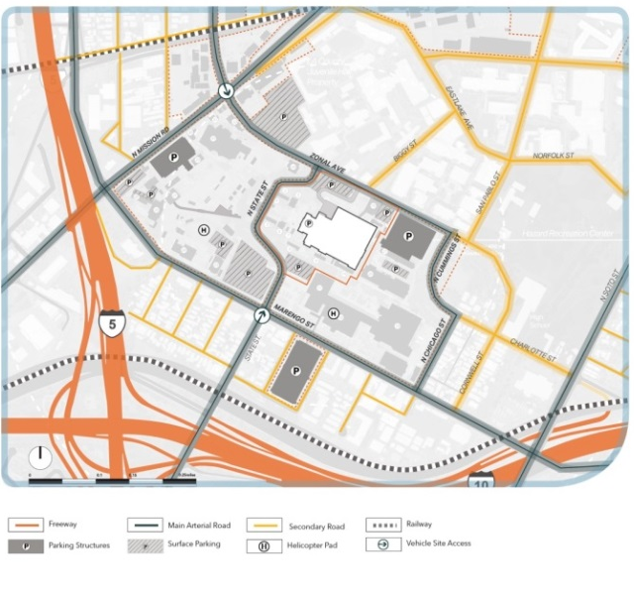
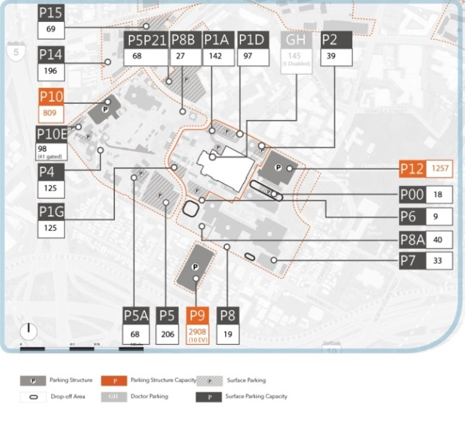
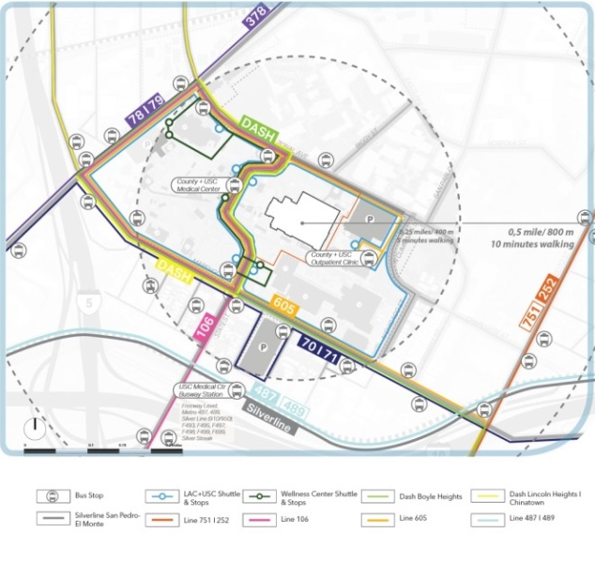
Transportation and Parking Overview
交通和停车概述
4 站
Accessibility I 无障碍交通
Parking I 停车处
Public Transit I 公共交通
Q: What would make it easier, safer, and more comfortable for you to get to and from General Hospital? 问：什么能让您更方便，更安全，更舒适地往返于综合医院？
At Station 4, you can comment on Transportation and Parking
在第 4站，您可以提供意見评论交通和停车
Notes:
Jessica
Station# 4
What would make it easier, safer, and more comfortable for you to get to and from General Hospital, and to get where you need to go within the surrounding neighborhoods?

Slide 32
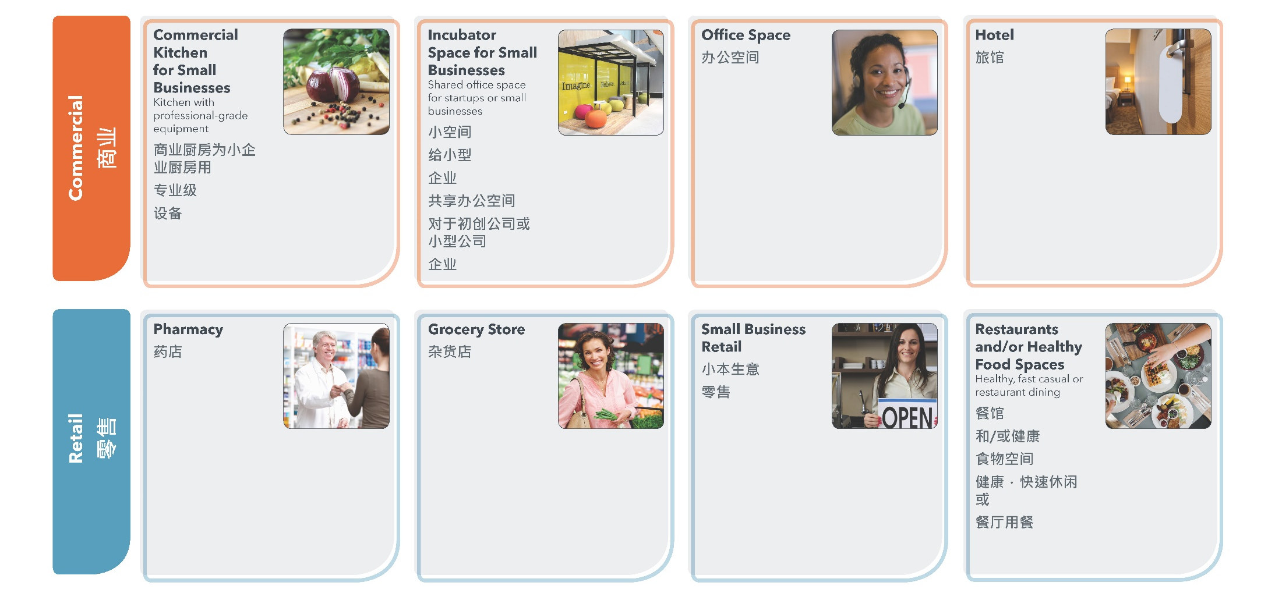
How Could the Building and West Campus Best Be Used to
Benefit the Community? 建筑和園区如何最好地利用社区？
5 站
Q: How do you think General Hospital and West Campus could best be used to benefit the community? 问：您认为综合医院和園区如何最好地用于社区福利？
At Station 5, you can comment on a variety of ideas, or add your own
在第5站，您可以评论各种想法，或添加自己的想法.
Notes:
Jessica

Slide 33
Key Community Issues
主要社区问题
6 站
以下问题是我们迄今从社区听到的关于他们关注的问题。
Environmental Justice / Pollution 环境正义/污染 | Food Security/ Grocery Stores 粮食安全/杂货店 | Gentrification & Displacement 授予和移位 | Homelessness 无家可归 | Long-Term Economic Security/Cultural Continuity and Resilience 长期经济安全/文化的连续性和弹性
Mental Health 精神健康 | Open Space 开放空间 | Social Justice 社会正义 | Transportation/ Parking 交通运输/停车 | Bioscience 生物科学
问：
您是否会更改或添加任何问题？哪些问题对您最重要？ 为什么？
在第6站，让我们知道哪些社区问题对您最重要
Notes:
Jessica

Slide 34
Next Steps 下一步
Project team will develop preliminary re-use ideas for General Hospital and West Campus
项目团队将为综合医院和園区制定初步的再利用理念
Fall 2019: Ongoing community engagement
2019年秋季：持续的社区参与
November 2019: Community At-Large Meeting #3
2019年11月：社区大型用户会议＃3

Slide 35
For more information 欲获得更多信息
Project Lead I 项目负责人
Kelly Quinn |首席执行官
Ivan Matthews I首席执行官
IMatthews@ceo.lacounty.gov 或 (213) 202 5825
Contact I 联系
Alex Villalobos I Barrio Planners
Alex@barrioplanners.com 或 (323) 726 7734
Sign up to receive email updates at sign-in table I
注册以在登录表中接收电子邮件更新

Slide 36
Community Meeting #2 | September 19, 2019
医院可行性研究
社区会议＃2 | 2019年9月19日
Notes:
Who opens? CEO?

